Slide 1
Modern Machine Learning — Kernel Principal Component Analysis
Kenneth E. Barner
Department of Electrical and Computer Engineering
University of Delaware

Slide 2
Kernel Principal Component Analysis
Objective: Apply a non-linear transformation to expand the feature space, then optimally represent the transformed data utilizing a lower dimensionality approximation
Principal Component Analysis (PCA): is a statistical method employing orthogonal transformations of (possibly) correlated variables (samples) into a set of uncorrelated variables (samples), referred to as principal components
Kernel PCA (KPCA): Extends the PCA method, realizing the result equivalent to expanding the features by a non-linear transformation and then applying PCA in the transformed feature space
KPCA allows superior separation in the higher dimensional transformation space; linear separation in the transformation space is nonlinear separation in the original observation space

Slide 3
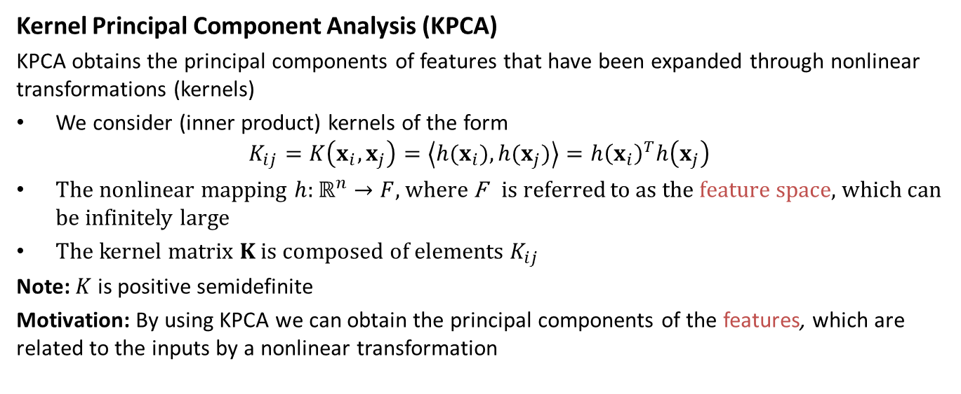
Kernel Principal Component Analysis
Kernel Principal Component Analysis (KPCA)
KPCA obtains the principal components of features that have been expanded through nonlinear transformations (kernels)
We consider (inner product) kernels of the form
$$K_{ij}=K\left(x_{i},x_{j}\right)=\left\langle h(x_{i}),h(x_{j})\right\rangle =h{\left(x_{i}\right)}^{T}h\left(x_{j}\right)$$
The nonlinear mapping $h:ℝ^{n}→F$, where F is referred to as the feature space, which can be infinitely large
The kernel matrix $K$ is composed of elements $K_{ij}$
Note: $K$ is positive semidefinite
Motivation: By using KPCA we can obtain the principal components of the features, which are related to the inputs by a nonlinear transformation

Slide 4
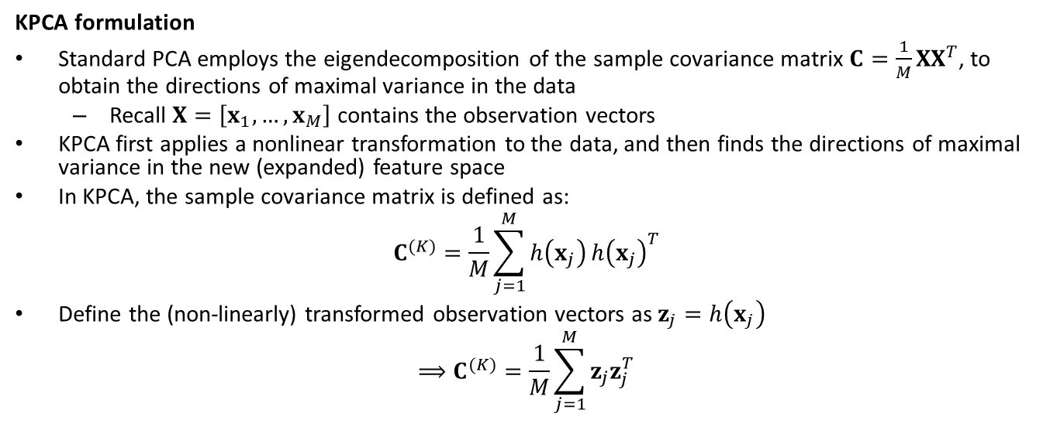
Kernel Principal Component Analysis
KPCA formulation
Standard PCA employs the eigendecomposition of the sample covariance matrix $C=\frac{1}{M}XX^{T}$, to obtain the directions of maximal variance in the data
Recall $X=\left[x_{1},…,x_{M}\right]$ contains the observation vectors
KPCA first applies a nonlinear transformation to the data, and then finds the directions of maximal variance in the new (expanded) feature space
In KPCA, the sample covariance matrix is defined as:
$$C^{(K)}=\frac{1}{M}\sum_{j=1}^{M}{h\left(x_{j}\right)}h{\left(x_{j}\right)}^{T}$$
Define the (non-linearly) transformed observation vectors as$z_{j}=h\left(x_{j}\right)$
$$⟹C^{(K)}=\frac{1}{M}\sum_{j=1}^{M}{z_{j}z_{j}^{T}}$$

Slide 5
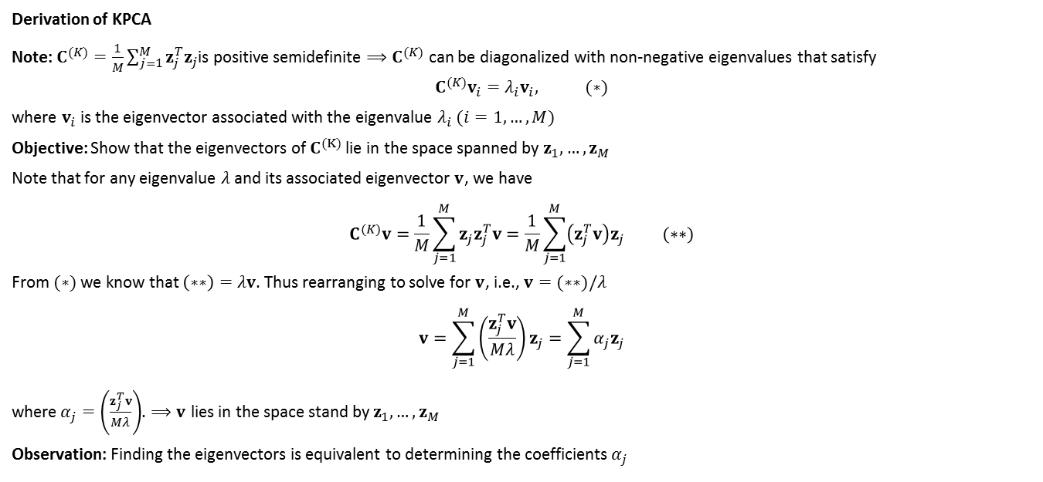
Kernel Principal Component Analysis
Derivation of KPCA
Note: $C^{(K)}=\frac{1}{M}\sum_{j=1}^{M}{z_{j}^{T}z_{j}}$is positive semidefinite $⟹C^{(K)}$ can be diagonalized with non-negative eigenvalues that satisfy
$${C^{(K)}v_{i}=λ}_{i}v_{i}, (∗)$$
where $v_{i}$ is the eigenvector associated with the eigenvalue $λ_{i}$ $(i=1,…,M)$
Objective: Show that the eigenvectors of $C^{(K)}$ lie in the space spanned by $z_{1}, …,z_{M}$
Note that for any eigenvalue $λ$ and its associated eigenvector $v$, we have
$$C^{(K)}v=\frac{1}{M}\sum_{j=1}^{M}{z_{j}z_{j}^{T}v}=\frac{1}{M}\sum_{j=1}^{M}{\left(z_{j}^{T}v\right)z_{j}} (∗∗)$$
From $(∗)$we know that $\left(∗∗\right)=λv$. Thus rearranging to solve for $v$, i.e., $v=(∗∗)/λ$
$$v=\sum_{j=1}^{M}{\left(\frac{z_{j}^{T}v}{Mλ}\right)z_{j}}=\sum_{j=1}^{M}{α_{j}z_{j}}$$
where$α_{j}=\left(\frac{z_{j}^{T}v}{Mλ}\right)$. $⟹v$ lies in the space stand by $z_{1}, …,z_{M}$
Observation: Finding the eigenvectors is equivalent to determining the coefficients $α_{j}$

Slide 6
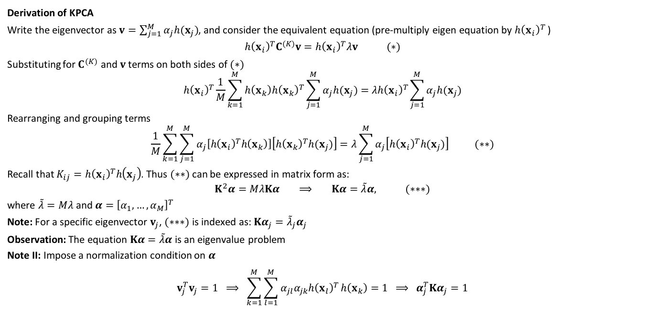
Kernel Principal Component Analysis
Derivation of KPCA
Write the eigenvector as $v=\sum_{j=1}^{M}{α_{j}h(x_{j})}$, and consider the equivalent equation (pre-multiply eigen equation by $h{\left(x_{i}\right)}^{T}$ )
$$h{\left(x_{i}\right)}^{T}C^{(K)}v=h{\left(x_{i}\right)}^{T}λv (∗)$$
Substituting for $C^{(K)}$ and $v$terms on both sides of $(∗)$ $$h{\left(x_{i}\right)}^{T}\frac{1}{M}\sum_{k=1}^{M}{h\left(x_{k}\right)h{\left(x_{k}\right)}^{T}}\sum_{j=1}^{M}{α_{j}h(x_{j})}=λh{\left(x_{i}\right)}^{T}\sum_{j=1}^{M}{α_{j}h(x_{j})}$$
Rearranging and grouping terms $$\frac{1}{M}\sum_{k=1}^{M}{\sum_{j=1}^{M}{α_{j}\left[h{\left(x_{i}\right)}^{T}h\left(x_{k}\right)\right]\left[h{\left(x_{k}\right)}^{T}h(x_{j})\right]}}=λ\sum_{j=1}^{M}{α_{j}\left[h{\left(x_{i}\right)}^{T}h(x_{j})\right]} (∗∗)$$
Recall that $K_{ij}=h{\left(x_{i}\right)}^{T}h\left(x_{j}\right)$. Thus $(∗∗)$can be expressed in matrix form as: $$K^{2}α=MλKα ⟹ Kα=\tilde{λ}α, (∗∗∗)$$
where $\tilde{λ}=Mλ$ and $α={\left[α_{1},…,α_{M}\right]}^{T}$
Note: For a specific eigenvector $v_{j}$, $(∗∗∗)$ is indexed as: $Kα_{j}={\tilde{λ}}_{j}α_{j}$
Observation: The equation $Kα=\tilde{λ}α$ is an eigenvalue problem
Note II: Impose a normalization condition on $α$
$$v_{j}^{T}v_{j}=1 ⟹ \sum_{k=1}^{M}{\sum_{l=1}^{M}{α_{jl}α_{jk}h{\left(x_{l}\right)}^{T}}h\left(x_{k}\right)}=1 ⟹ α_{j}^{T}Kα_{j}=1$$

Slide 7
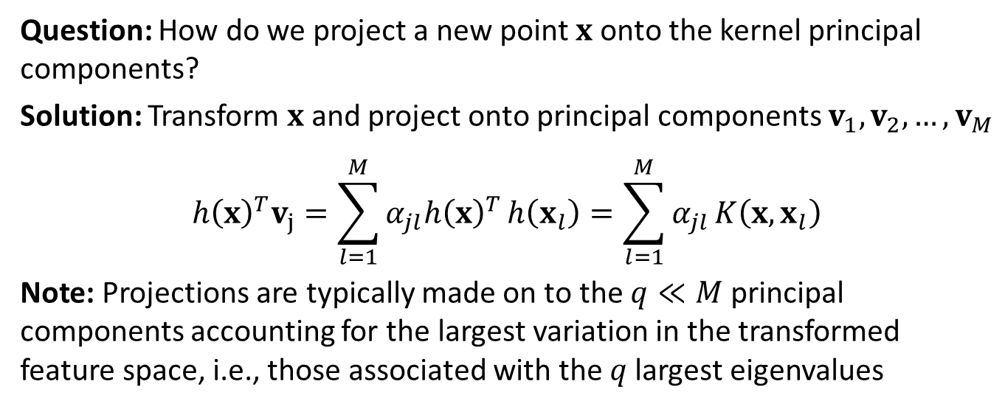
Kernel Principal Component Analysis
Question: How do we project a new point $x$onto the kernel principal components?
Solution: Transform $x$ and project onto principal components $v_{1},v_{2},…,v_{M}$
$$h{\left(x\right)}^{T}v_{j}=\sum_{l=1}^{M}{α_{jl}h{\left(x\right)}^{T}}h\left(x_{l}\right)=\sum_{l=1}^{M}{α_{jl}}K\left({x,x}_{l}\right)$$
Note: Projections are typically made on to the $q≪M$ principal components accounting for the largest variation in the transformed feature space, i.e., those associated with the $q$largest eigenvalues

Slide 8
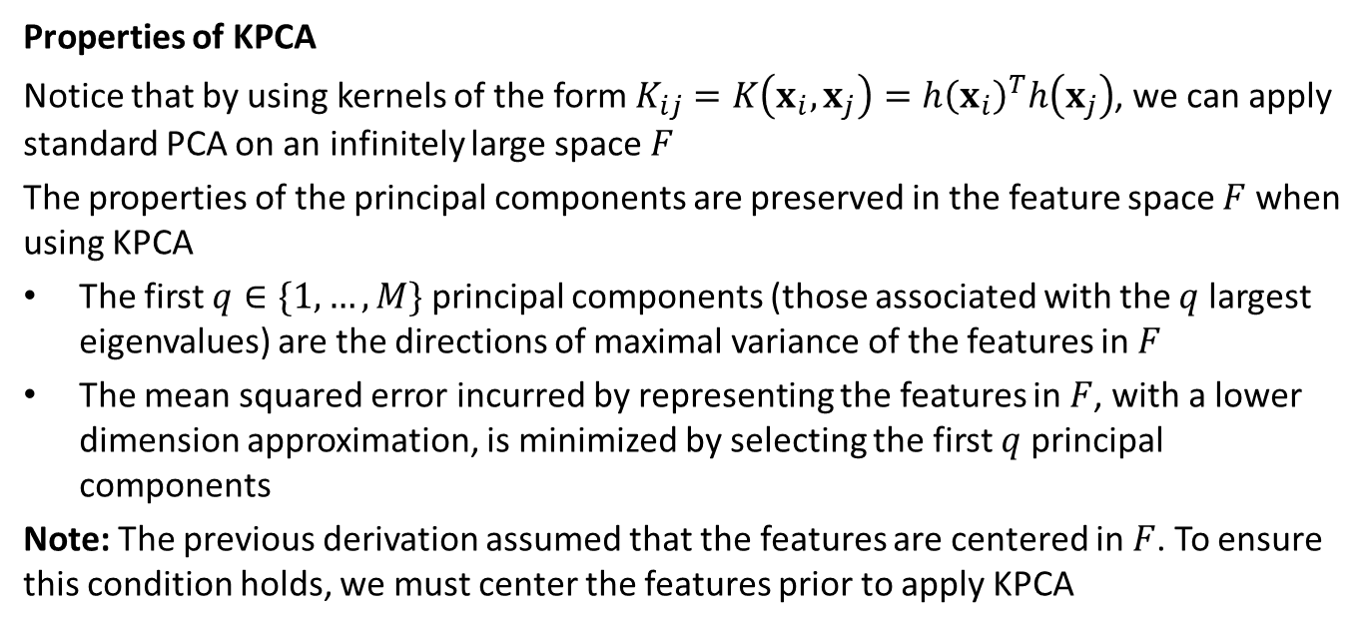
Kernel Principal Component Analysis
Properties of KPCA
Notice that by using kernels of the form $K_{ij}=K\left(x_{i},x_{j}\right)=h{\left(x_{i}\right)}^{T}h\left(x_{j}\right)$, we can apply standard PCA on an infinitely large space $F$
The properties of the principal components are preserved in the feature space $F$ when using KPCA
The first $q∈\{1,…,M\}$ principal components (those associated with the $q$largest eigenvalues) are the directions of maximal variance of the features in $F$
The mean squared error incurred by representing the features in $F$, with a lower dimension approximation, is minimized by selecting the first $q$ principal components
Note: The previous derivation assumed that the features are centered in $F$. To ensure this condition holds, we must center the features prior to apply KPCA

Slide 9
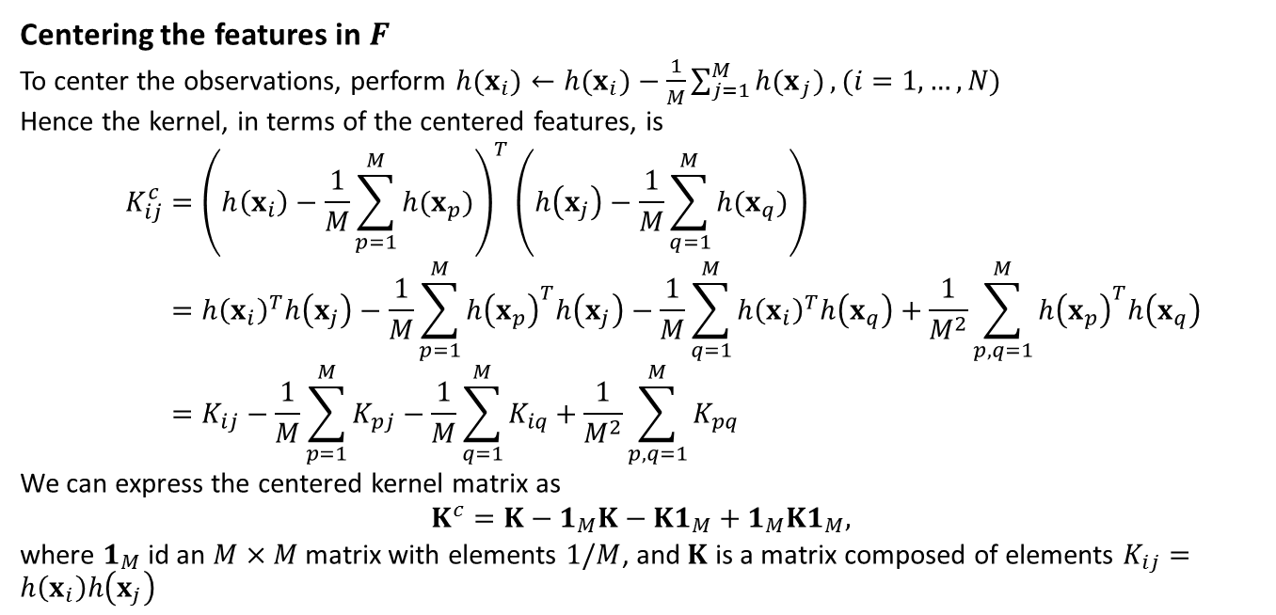
Kernel Principal Component Analysis
Centering the features in $F$
To center the observations, perform $h(x_{i})←h(x_{i})−\frac{1}{M}\sum_{j=1}^{M}{h{(x}_{j})}, (i=1,…,N)$
Hence the kernel, in terms of the centered features, is
$$K_{ij}^{c}={\left(h\left(x_{i}\right)−\frac{1}{M}\sum_{p=1}^{M}{h{(x}_{p})}\right)}^{T}\left(h\left(x_{j}\right)−\frac{1}{M}\sum_{q=1}^{M}{h{(x}_{q})}\right) \\ =h{\left(x_{i}\right)}^{T}h\left(x_{j}\right)−\frac{1}{M}\sum_{p=1}^{M}{h{\left(x_{p}\right)}^{T}h\left(x_{j}\right)}−\frac{1}{M}\sum_{q=1}^{M}{h{\left(x_{i}\right)}^{T}h\left(x_{q}\right)}+\frac{1}{M^{2}}\sum_{p,q=1}^{M}{h{\left(x_{p}\right)}^{T}h\left(x_{q}\right)} \\ =K_{ij}−\frac{1}{M}\sum_{p=1}^{M}{K_{pj}}−\frac{1}{M}\sum_{q=1}^{M}{K_{iq}}+\frac{1}{M^{2}}\sum_{p,q=1}^{M}{K_{pq}}$$
We can express the centered kernel matrix as
$$K^{c}=K−1_{M}K−K1_{M}+1_{M}K1_{M},$$
where $1_{M}$ id an $M×M$ matrix with elements $1/M$, and $K$ is a matrix composed of elements $K_{ij}=h\left(x_{i}\right)h\left(x_{j}\right)$

Slide 10
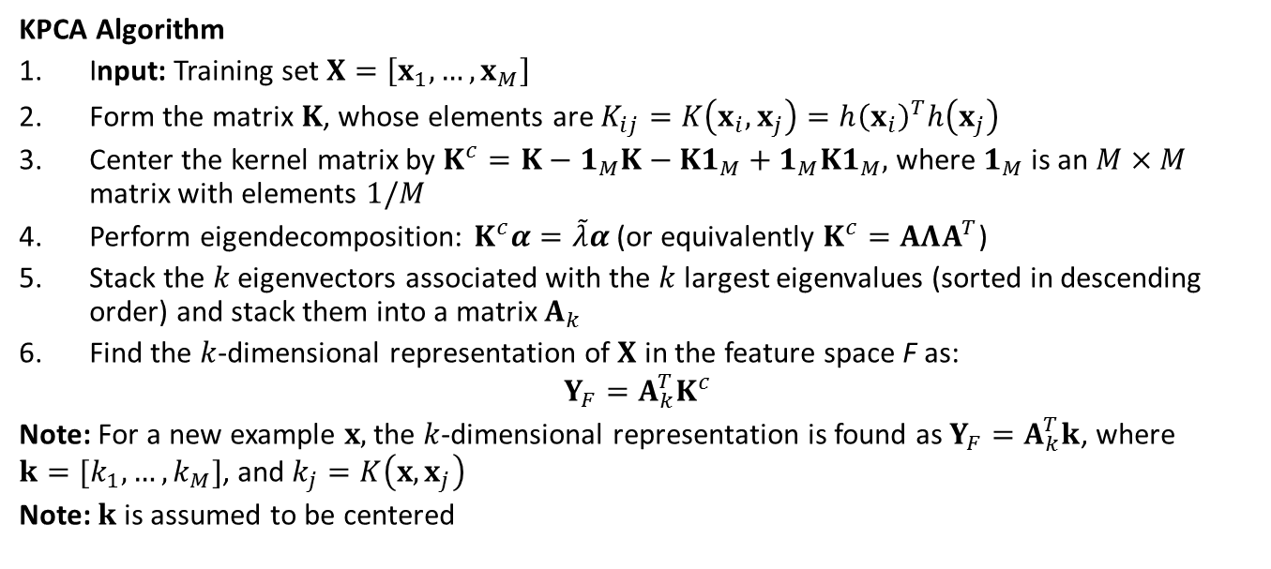
Kernel Principal Component Analysis
KPCA Algorithm
Input: Training set $X=\left[x_{1},…,x_{M}\right]$
Form the matrix $K$, whose elements are $K_{ij}=K\left(x_{i},x_{j}\right)=h{\left(x_{i}\right)}^{T}h\left(x_{j}\right)$
Center the kernel matrix by $K^{c}=K−1_{M}K−K1_{M}+1_{M}K1_{M},$ where $1_{M}$ is an $M×M$ matrix with elements $1/M$
Perform eigendecomposition: $K^{c}α=\tilde{λ}α$ (or equivalently $K^{c}=ΑΛΑ^{T}$)
Stack the $k$ eigenvectors associated with the $k$ largest eigenvalues (sorted in descending order) and stack them into a matrix $Α_{k}$
Find the $k$-dimensional representation of $X$ in the feature space F as:
$$Y_{F}=Α_{k}^{T}K^{c}$$
Note: For a new example $x,$ the $k$-dimensional representation is found as $Y_{F}=Α_{k}^{T}k$, where $k=[k_{1},…,k_{M}]$, and $k_{j}=K\left(x,x_{j}\right)$
Note: $k$is assumed to be centered

Slide 11
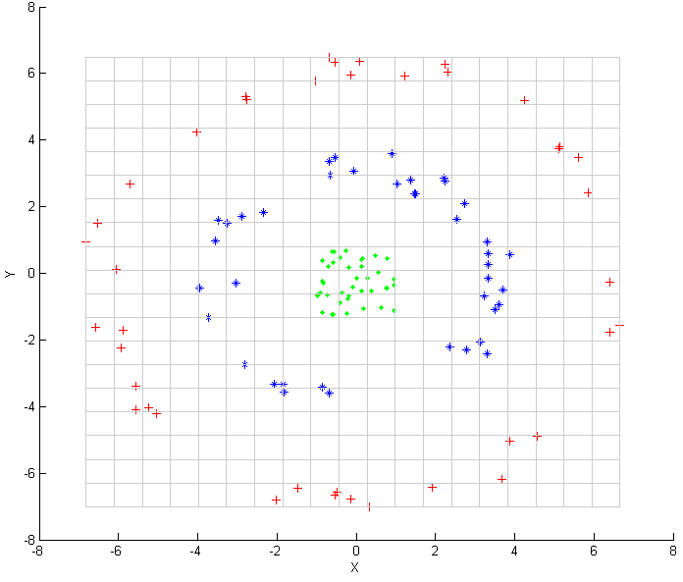
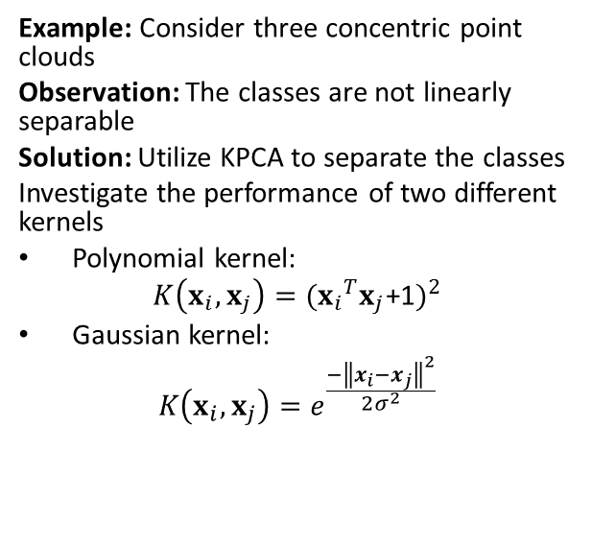
Kernel Principal Component Analysis
Example: Consider three concentric point clouds
Observation: The classes are not linearly separable
Solution: Utilize KPCA to separate the classes
Investigate the performance of two different kernels
Polynomial kernel:
$$K\left(x_{i},x_{j}\right)={({x_{i}}^{T}x_{j}\text{+1})}^{2}$$
Gaussian kernel:
$$K\left(x_{i},x_{j}\right)=e^{\frac{{−\left\|x_{i}−x_{j}\right\|}^{2}}{2σ^{2}}}$$
Figures are from https://en.wikipedia.org/wiki/Kernel_principal_component_analysis

Slide 12
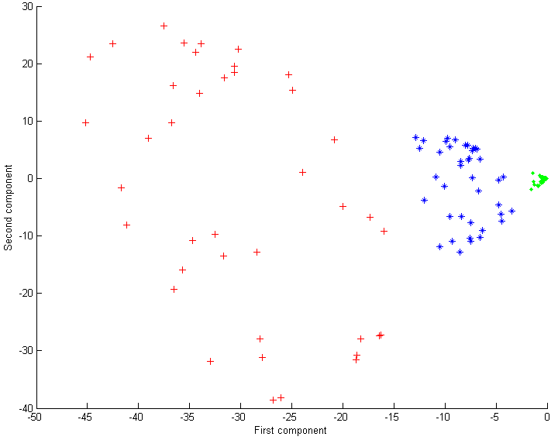
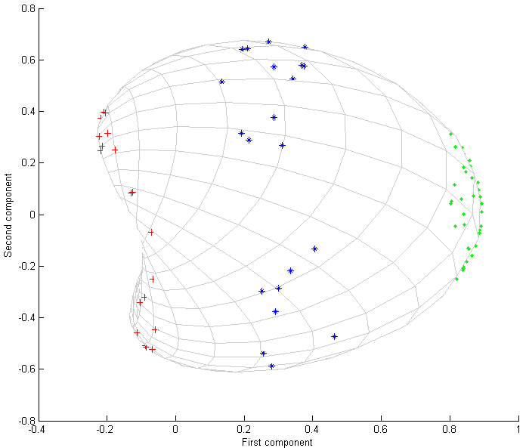
Kernel Principal Component Analysis
Input points before kernel PCA.
Output after kernel PCA, with polynomial kernel
Output after kernel PCA, with a Gaussian kernel.
Observation: The three point clouds are linearly separable for both kernels, utilizing only the first principal component
Figures are from https://en.wikipedia.org/wiki/Kernel_principal_component_analysis

Slide 13
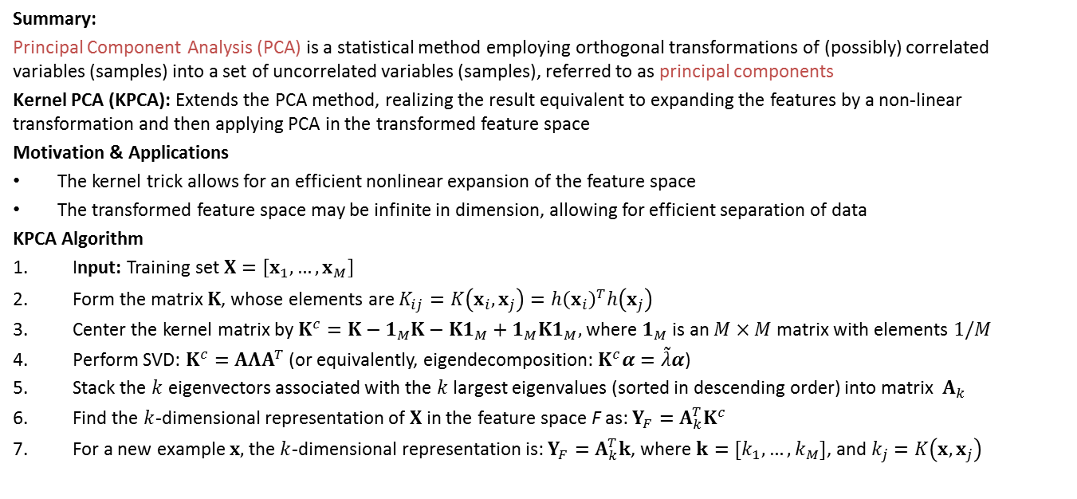
Kernel Principal Component Analysis
Summary:
Principal Component Analysis (PCA) is a statistical method employing orthogonal transformations of (possibly) correlated variables (samples) into a set of uncorrelated variables (samples), referred to as principal components
Kernel PCA (KPCA): Extends the PCA method, realizing the result equivalent to expanding the features by a non-linear transformation and then applying PCA in the transformed feature space
Motivation & Applications
The kernel trick allows for an efficient nonlinear expansion of the feature space
The transformed feature space may be infinite in dimension, allowing for efficient separation of data
KPCA Algorithm
Input: Training set $X=\left[x_{1},…,x_{M}\right]$
Form the matrix $K$, whose elements are $K_{ij}=K\left(x_{i},x_{j}\right)=h{\left(x_{i}\right)}^{T}h\left(x_{j}\right)$
Center the kernel matrix by $K^{c}=K−1_{M}K−K1_{M}+1_{M}K1_{M},$ where $1_{M}$ is an $M×M$ matrix with elements $1/M$
Perform SVD: $K^{c}=ΑΛΑ^{T}$ (or equivalently, eigendecomposition: $K^{c}α=\tilde{λ}α$)
Stack the $k$ eigenvectors associated with the $k$ largest eigenvalues (sorted in descending order) into matrix $Α_{k}$
Find the $k$-dimensional representation of $X$ in the feature space F as: $Y_{F}=Α_{k}^{T}K^{c}$
For a new example $x,$ the $k$-dimensional representation is: $Y_{F}=Α_{k}^{T}k$, where $k=[k_{1},…,k_{M}]$, and $k_{j}=K\left(x,x_{j}\right)$

